Slide 1
Top 20 de la musica POP
DAYANA QUIROGA

Slide 2

We Are Young – fun. feat. Janelle Monae

Slide 3

2. Somebody That I Used to Know – Gotye feat. Kimbra

Slide 4

3. Glad You Came – The Wanted

Slide 5

4. Drive By – Train

Slide 6

5. Rumour Has It – Adele

Slide 7
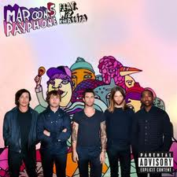
6. Payphone – Maroon 5

Slide 8

7. What Makes You Beautiful – One Direction

Slide 9

8. Stronger (What Doesn’t Kill You) – Kelly Clarkson

Slide 10

9. Part of Me – Katy Perry

Slide 11

10. Call Me Maybe – Carly Rae Jepsen

Slide 12

11. Wild Ones – Flo Rida feat. Sia

Slide 13
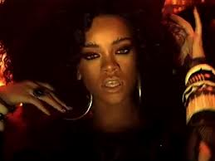
12. Where Have You Been – Rihanna

Slide 14

13. Domino – Jessie J

Slide 15

14. Scream – Usher

Slide 16

15. Set Fire to the Rain – Adele

Slide 17

16. We Found Love – Rihanna feat. Calvin Harris

Slide 18

17. Paradise – Coldplay

Slide 19

18. Brokenhearted – Karmin

Slide 20

19. Give Your Heart a Break – Demi Lovato

Slide 21

20. Shadow Days – John Mayer

